Slide 1
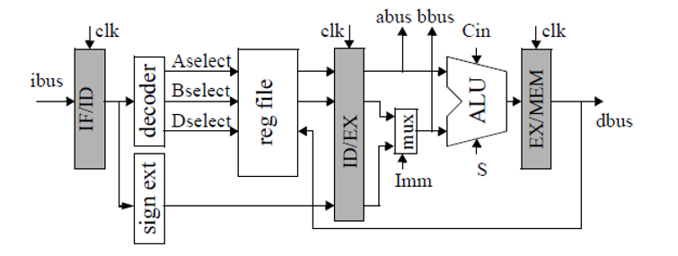
Project 6 : 3 Stage Pipe-lined CPU

Slide 4
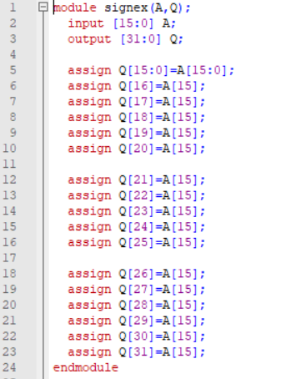
Sign Extended
Copy first 15 bits as it is
Extend the 16 bit, which is a sign bit.

Slide 5
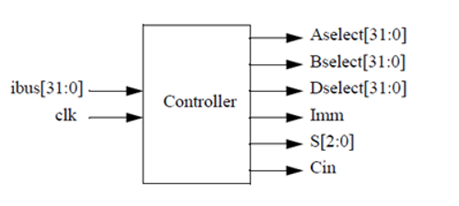

Slide 6
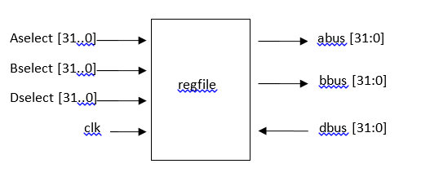

Slide 7
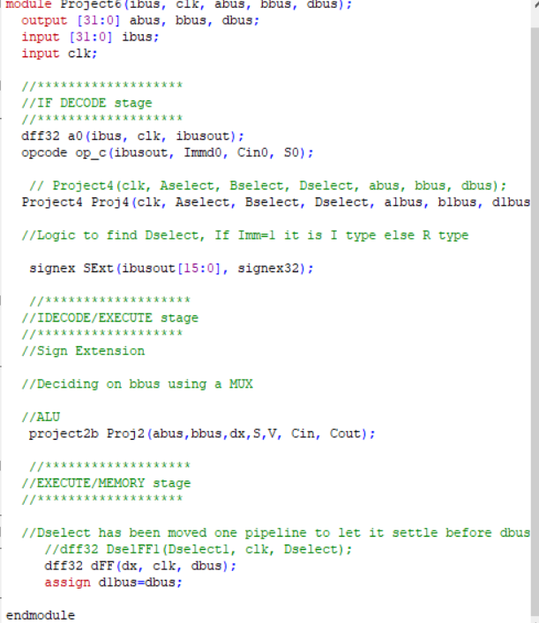
Project 6

